Slide 1
Persuasion & social media structures
COMS2200 – computer tools for communication

Slide 2
Persuasion and social media structures:
overview
Overview: what do we mean by persuasion?
Social media:
-distribution & media technologies
-structures & functions; rhetorical / persuasive functions

Slide 3
Approaches to persuasion:
Ancient: logic, emotion, character
Modern: (self) identification, drama / narrative, advertising / agitprop
Overview / recap: what is persuasion

Slide 4
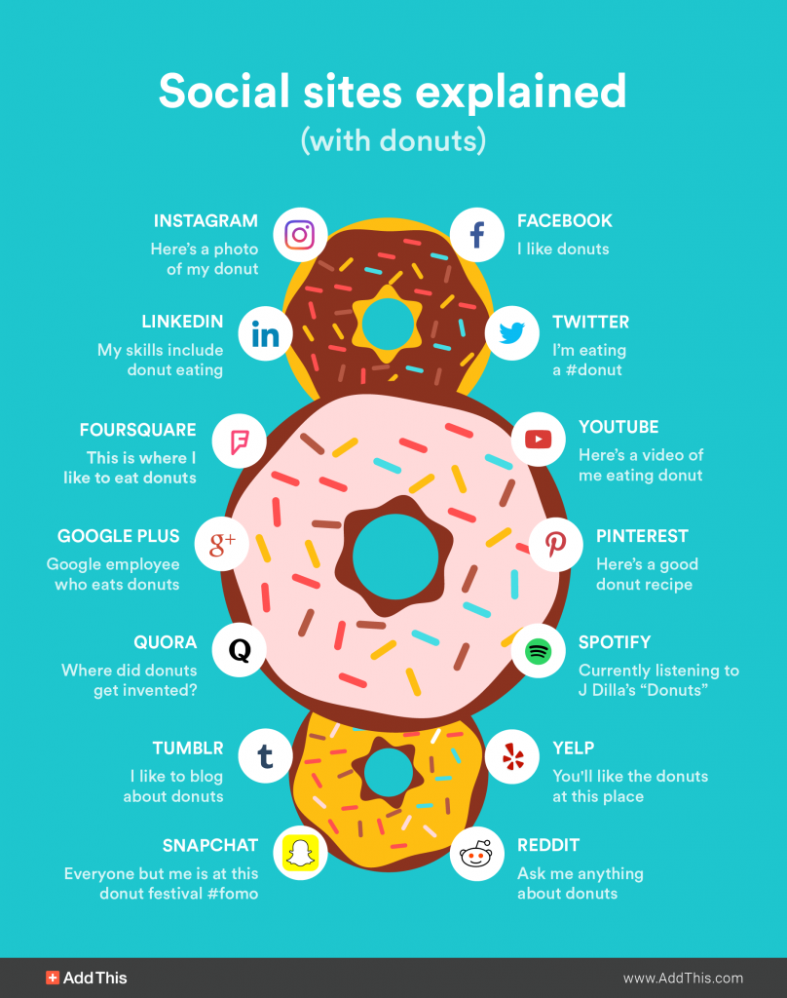
Social media: common view

Slide 5
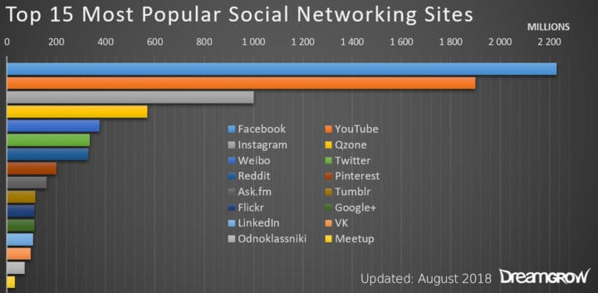
Social media today: distribution & media tech
→ Fundamentally reliant on web technologies (the web itself, HTML, scripts, client-server / IP networks and tools, databases, XML and cloud applications
→ Fundamentally bound by rules of digital media: sampling, time-independence, transportability of data
→ Still emerging, evolving:
balancing privacy vs personal exploitation
balancing disruption unregulated / self-regulated & regulated economy

Slide 6
Facebook
→ Symbolic structures: the wall, the update, the post // images, links, videos, text
Rhetorical function: the commons, the friends network, shared interests / dislikes; surprising use: the echo chamber, propaganda for elections
https://www.cnet.com/news/facebook-isnt-a-community-its-a-weapon/

Slide 7
YouTube
→ Symbolic structures: the channel, the subscription, videos, audio, text
→ Rhetorical function: personal TV, non-official shows, public sourcing of for-sale content, surprising use: instructional video / how to / education

Slide 8
Instagram
→ Symbolic structures: photo album, visual commons, self(ie)-expression, images, movies, text
→ Rhetorical function: personal diary, electronic mirror, surprising use: food catalog, cat (pet) catalog, narcissistic expression

Slide 9
Twitter
→ Symbolic structures: the tweet / sound bite, abstract, gossip, text, pictures, links
→ Rhetorical function: advertising, notification, news, brief information, social comment, social judgement, surprising use: POTUS propaganda platform

Slide 10
?
Questions

